Slide 1
Dragons’ Reign
Symbiotic Games

Slide 2
Team Roles
Team Lead
Jordon Kopp
Lead Programmer
Vince Smeraldo
Programmers
Matt Kalafut
Mark Muniz
Derek Finch
Josh Kopp
Designers (freelance artists)
Marco Malek
Frank Margarella

Slide 3
Scope/Purpose Statement
Scope
Standalone, functioning prototype
Top-down 2D fantasy RPG
Android platform
Purpose
Entertain
Playable anywhere

Slide 4
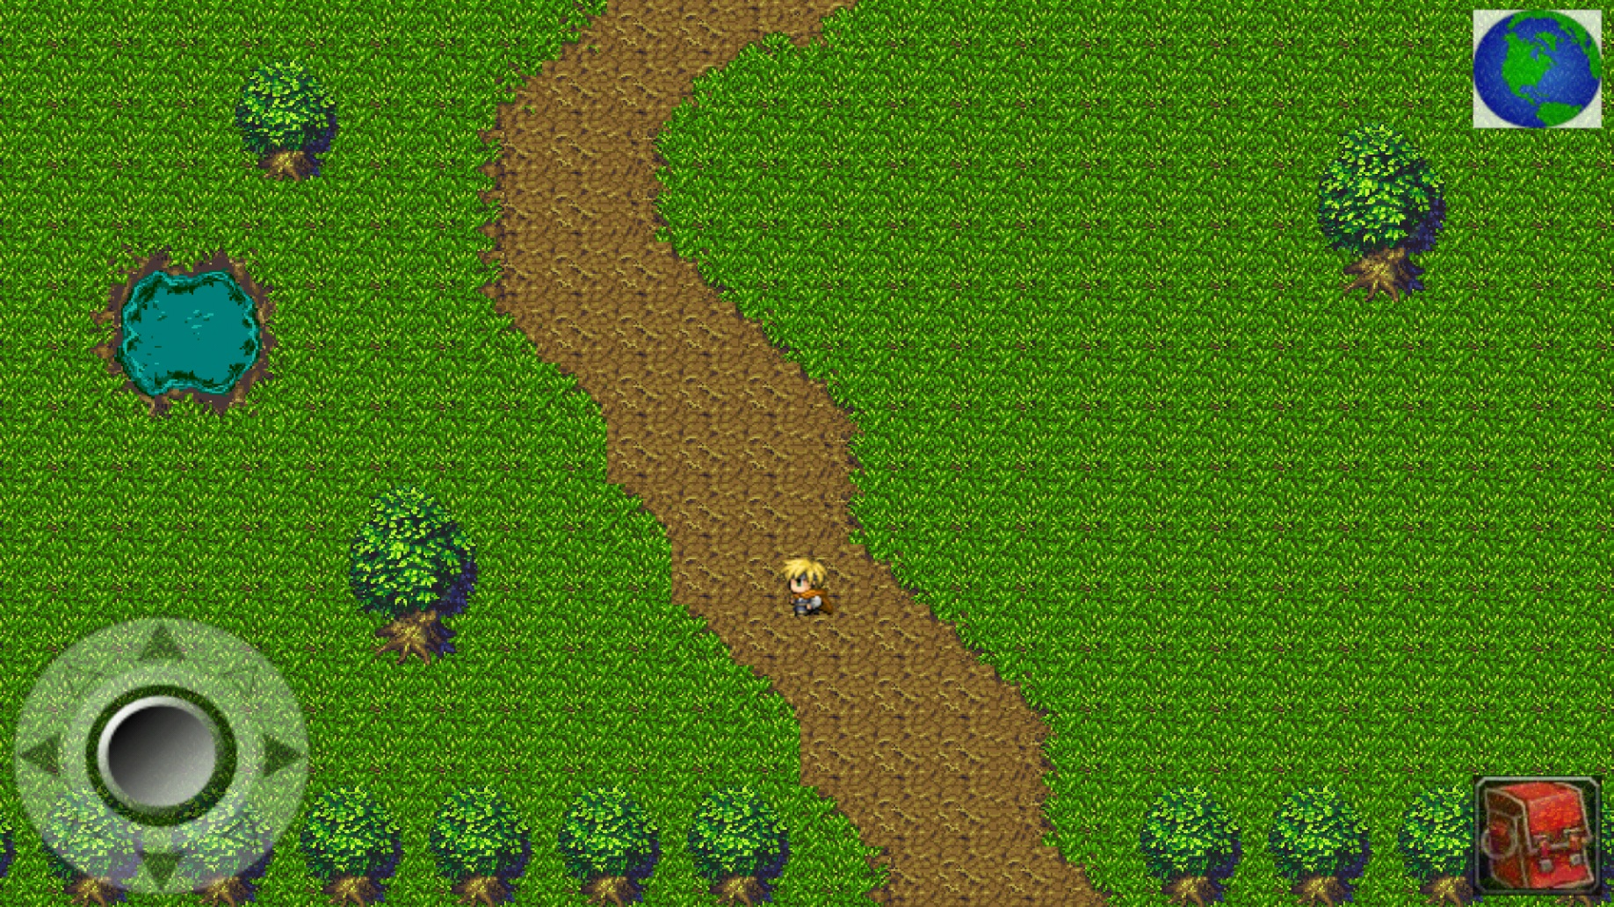
Player Screen/User Interface

Slide 5
Milestones
Finalized GDD (Game Design Document)
Finalized TDD (Technical Design Document)
Finished UI (User Interface)
Finished battle system
Finish character class
Finished playable zones
Finished major city
Finished completed game

Slide 6
Project Planning

Slide 7
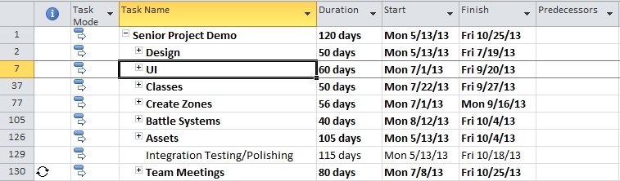
Project Planning

Slide 8
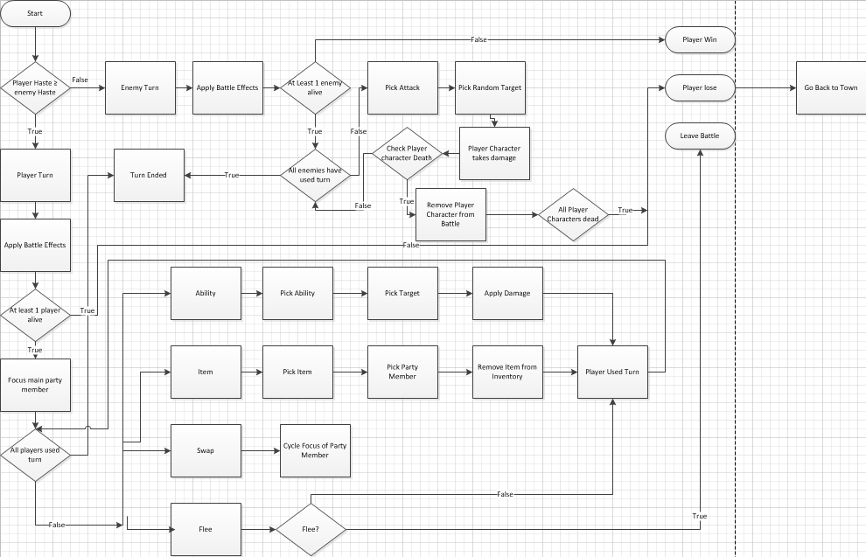
Project Planning: Battle System

Slide 9
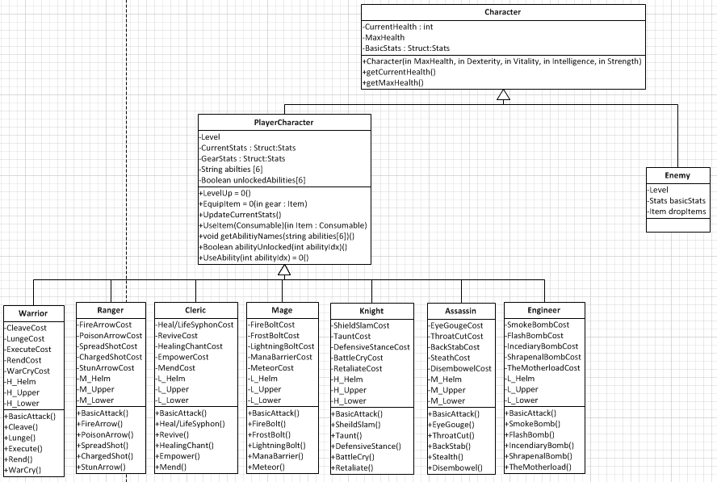
Project Planning: Character Class Diagrams

Slide 10
Test Plan
Four main areas of testing
GUI
Player Movement
Battle System
Zones
Each area has a detailed list of what needs to be tested
High Priority errors must be fixed and tested
Outstanding low or medium-priority errors must be signed off by Team Lead as acceptable

Slide 11
Development Environment
Android SDK
Java
Eclipse
Tiled
Tile Engine
TexturePacker
Creates Sprite Sheets
GitHub
Version Control
Online Repository
GIMP 2
Art Editing Tool

Slide 12
Learning Curve
Android SDK
First attempt at developing on the Android platform
AndEngine
Scarcely documented open source library
Rarely updated
Community based bug fixes
Java
Team not formally trained in Java
Tiled
New tile engine tool

Slide 13
Assets
Art
Open-Source
Freelance Artists
Audio
Open-Source

Slide 14
Game Summary
Backstory
The world is unaware of the presence of dragons within their peaceful societies. Until that fateful day when dragons awakened, the world was never the same.
Story
Dragons have awakened in each of the regions and the local hostile tribes now worship them as Gods. It is the duty of the player to defeat the dragons in each of the regions, shattering the hostile tribes that worship them in the process. This eventually leads to defeating the Elder Dragon to rid the world of dragons forever.

Slide 15
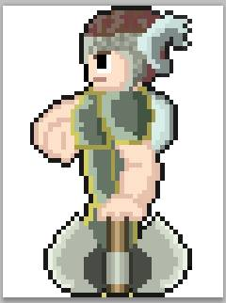
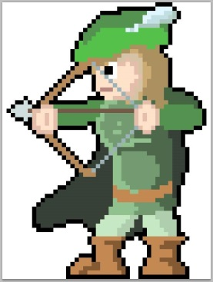
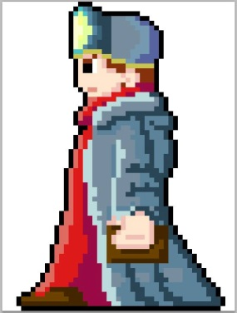
Classes
Warrior - Stamina
Melee
Heavy armor
One/two-handed axes/maces/swords
Ranger - Energy
Ranged
Medium armor
Shortbow/crossbow/longbow
Cleric - Mana
Support
Light armor
Wands/orbs/staves

Slide 16

Warrior Abilities
Basic Attack – level 1
Cleave – level 1
Lunge – level 10
Stun effect
Execute – level 10
Damage based on resource depletion
Rend – level 20
Bleed effect
War Cry – level 20
Grants damage to entire party

Slide 17

Ranger Abilities
Basic Attack – level 1
Fire Arrow - level 1
Burn effect
Poison Arrow – level 10
Poison effect
Spread Shot – level 10
Charged Shot – level 20
Stun Arrow – level 20
Stun

Slide 18

Cleric Abilities
Basic Attack – level 1
Mend – level 1
Life Syphon – level 10
Returns half health
Revive – level 10
Resurrect fallen party member
Healing Chant – level 20
Heals entire party
Empower - level 20
Grants stats to entire party

Slide 19
Attributes
Strength
Increases physical damage
Dexterity
Increases physical damage
Physical critical strike chance
Vitality
Increases base health
Intelligence
Increases spell damage
Spell critical strike chance

Slide 20
Zones
Starter Village
Inn
Plains
Mountains

Slide 21
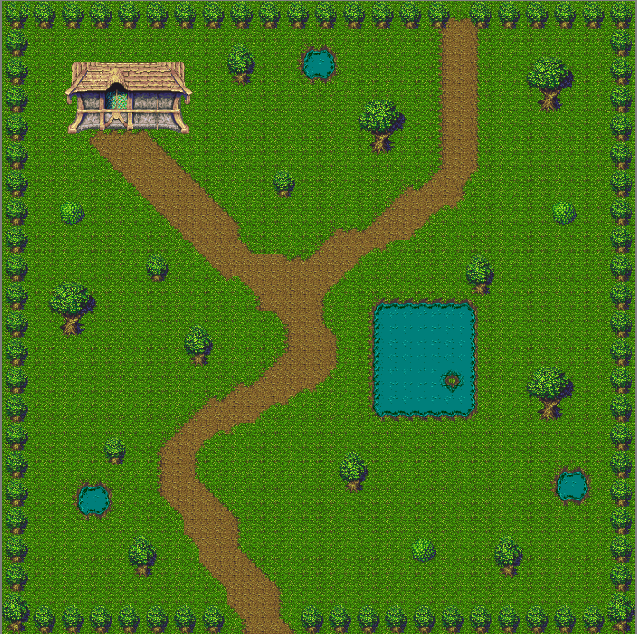
Starter Village

Slide 22
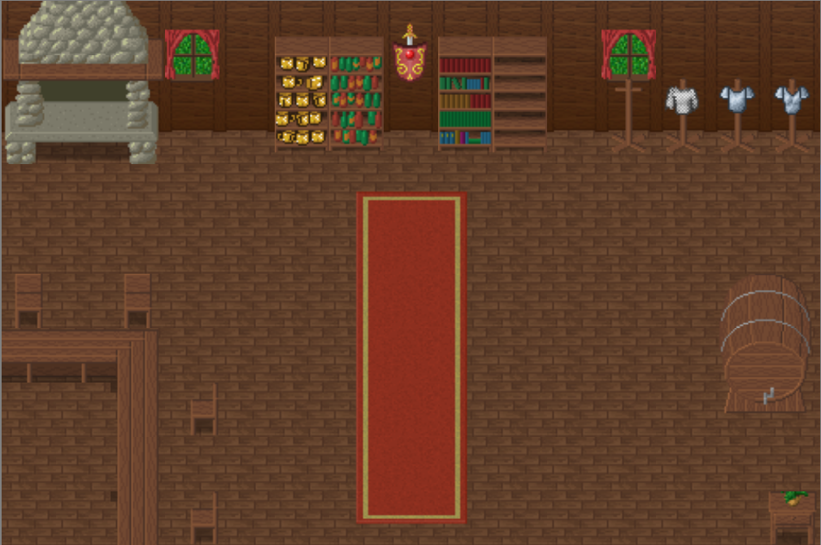
Inn

Slide 23
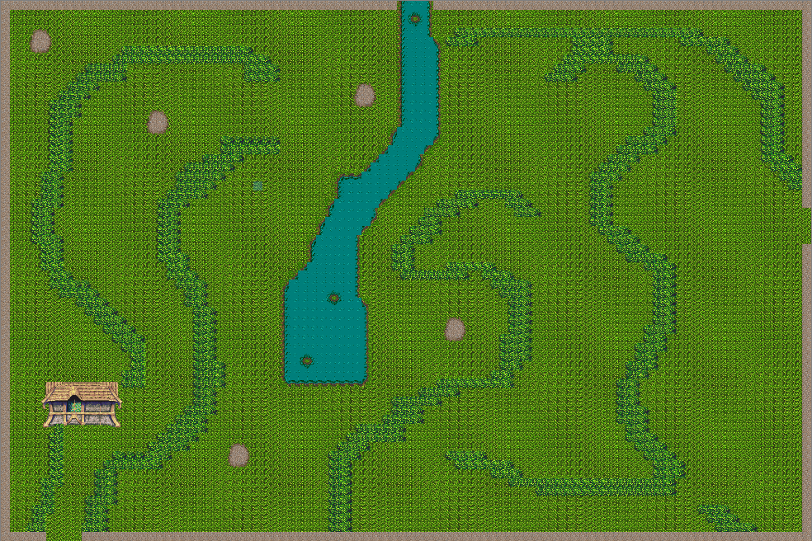
Plains

Slide 24
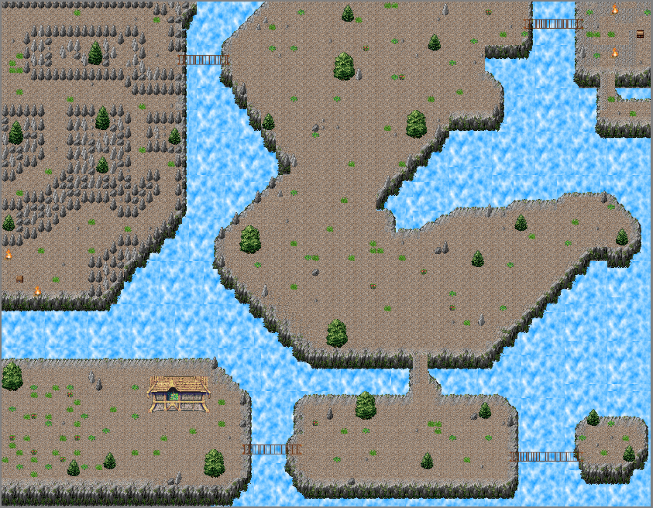
Mountains

Slide 25
Battle System

Slide 26
Battle System
Turn order based on internal haste value of the enemy
Each side takes turns
Continues until combat ends
Pop-up occurs at end of combat
Experience
Battle rations
Consumed on pickup
Health/resource gain
Does nothing if player has full health and full resource
Loot and inventory
Drag the desired items from loot box to inventory

Slide 27
Battle System
Battle effects
Blind – chance to miss – 2 turns
Daze – reduced damage – 2 turns
Poison – damage per turn – 2 turns
Burn – damage per turn – 2 turns
Chill – reduces defenses – 2 turns
Stun – blocks all attacks – 1 turn
Bleed – damage per turn – 2 turns

Slide 28
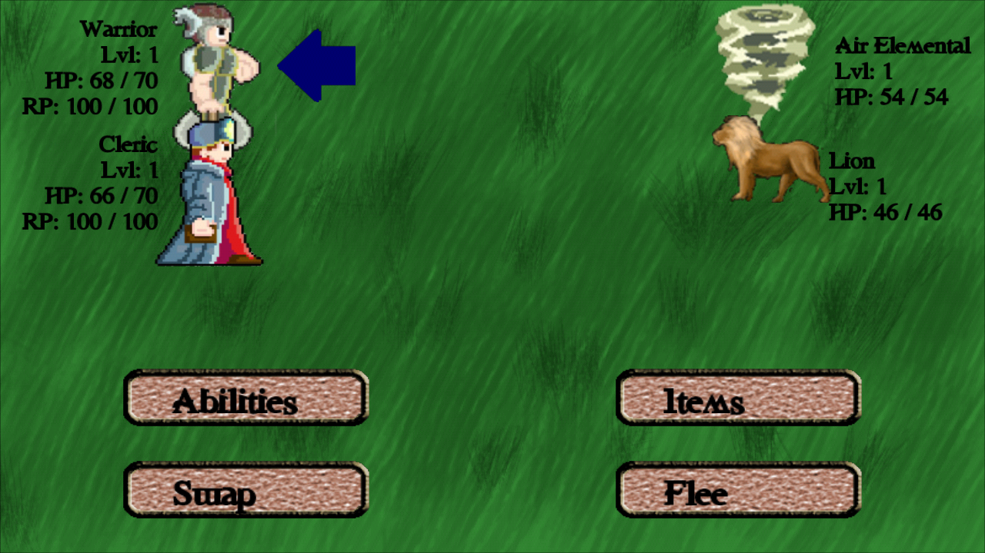
Battle System

Slide 29
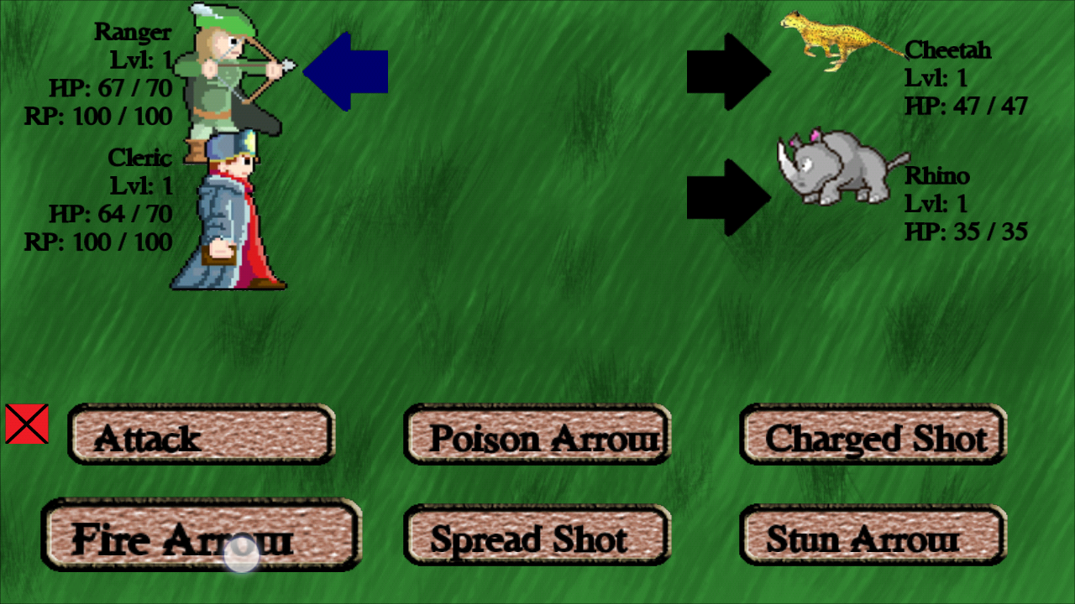
Battle System

Slide 30
What’s to come

Slide 31
Scope Cutbacks
Shop
Tiered abilities
Non-Playable Characters (NPCs) that generate a battle
Bosses
Treasure Chests
Quests
Challenges
Puzzles
Locked Doors
Cutscenes

Slide 32
Future
Classes
Assassin
Engineer
Mage
Knight
Zones
Caves
Desert
Tropics
Forest

Slide 33
Future
Fast Travel
Professions/crafting
Ally inventory
Persistent poison damage after battles
Micro-transactions
Currency
Diamonds
Allows instant access to content
Bundles
Remove ads

Slide 34
Post Mortem
Learning Java
Blended Methodologies
Subversion control
Large initial scope
Deadlines
What Worked
What Didn’t Work
Communication
Schedules
Time Management

Slide 35
References
Art
Antonio D. Salazar: http://tufftony.deviantart.com/art/Sky-Background-Attempt-01-301002187
Blarumyrran: http://opengameart.org/content/modified-32x32-treasure-chest
Daniel Cook, Jetrel, Bertram, et al. http://opengameart.org/content/2d-lost-garden-zelda-style-tiles-resized-to-32x32-with-additions
Daneeklu: http://opengameart.org/content/extended-lpc-magic-pack
Daren: http://www.pscave.com/forums/viewtopic.php?p=47221
DTHerculean: http://dtherculean.deviantart.com/art/Cheetah-Creature-Design-208714509

Slide 36
References
Art
Frank Margarella – Freelance artist
Globu: http://forum.shrapnelgames.com/showthread.php?t=44932
Gold-Ring-951: http://www.deviantart.com/morelikethis/artists/361935970?view_mode=2
Hawk14: http://gmc.yoyogames.com/index.php?showtopic=273665
Jordon Trudget: http://opengameart.org/content/creature-and-npc-sprites-for-ardentryst-by-jordan-trudgett
Marco Malek – Freelance Artist
MazakuHQ: http://mazakuhq.deviantart.com/art/Evil-shadow-sprites-314669338
PxlCobit: http://pxlcobit.deviantart.com/art/MLSS-Animal-Buddies-Sprites-Sheet-284513305

Slide 37
References
Art
Stefan Beller: http://opengameart.org/content/the-mana-world-woodland-indoor-tileset
Terra-Chan: http://www.rpgmakervx.net/lofiversion/index.php/t45371.html
Wombat: http://forums.themanaworld.org/viewtopic.php?f=8&t=11291
XxcrystalluvsyouxX: http://xxcrystalluvsyouxx.deviantart.com/art/wolf-crystal-sprite-sheet-x3-389199869
Zabin: http://opengameart.org/content/2d-lost-garden-tileset-transition-to-jetrels-wood-tileset

Slide 38
References
Audio
Knarmahfox http://www.freesound.org/people/knarmahfox/sounds/57749/
Noirenex http://www.freesound.org/people/noirenex/sounds/159401/
Setuniman http://www.freesound.org/people/Setuniman/sounds/173067/
Engine
Jayme Schroeder, Brian Broyles, and PACKT Publishing: AndEngine for Android Game Development Cookbook
http://www.andengine.org/forums/
http://stackoverflow.com/

Slide 39
References
Special Thanks
Professor Pasierb
Professor Sharpe

Slide 40
Demo

Slide 41
Q&A
Thanks for your time

